Slide 1
Weekly Meeting – AI Training
FIXED-TERM Tran To Bang Trinh EMC-TM-XC

Slide 2
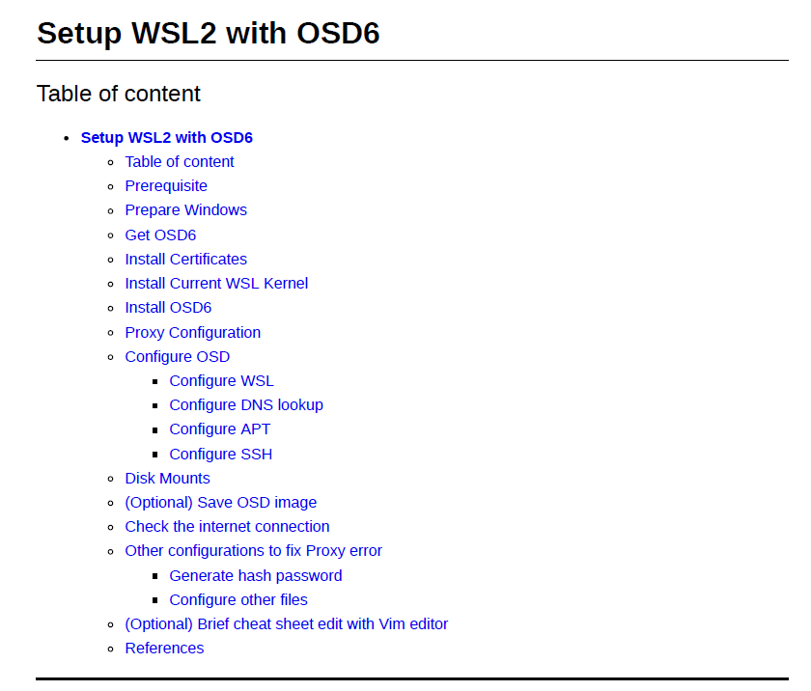
Install and Configure OSD to run on WSL2.
Fix Proxy error.
Write document.

Slide 3
Prepare dependencies and utilities to train models (conda, frameworks and connect to VSCode).
Start to learn OpenCV.

